Slide 1
Electric Cars - an update
John Willis
HKD Transition
May 2020

Slide 2
Background
Previous ‘meet-up’ was in Nov 2017 … no big changes since then
Sale of new petrol and diesel cars due to be banned – originally by 2040, now 2035 proposed (even earlier if possible – eg 2032)
Hybrids to be included in ban, although some consider plug-in hybrids should be allowed
Sales of battery electric vehicles has increased considerably, but still only 1.6% of total (2019 figures)
Other categories: PHEV – 1.5%, HEV – 6.9%
HEV includes ‘Mild Hybrid’ – explained later …
The number of available models has expanded rapidly, although many are higher priced
Despite limited government support, manufacturers have recently introduced a large number of PHEV models (appealing option for business users)

Slide 3
Types of electric and hybrid cars
Fully electric cars (EV) – eg Nissan Leaf, Renault Zoe, Tesla, BMW i3, Hyundai Ioniq, Mini Electric
Extended range electric vehicles (E-REV) – with small petrol engine to charge battery – eg LEVC London taxi, original BMW 3i, but largely disappeared in cars
Plug-in hybrids (PHEV) – eg Mitsubishi Outlander, VW Golf GTE, Kia Niro (typically 25 -30 miles on battery)
Conventional ‘self-charging’ hybrids (HEV) – eg Toyota Prius, other Toyota models, Hyundai Ioniq, Kia Niro
Mild hybrids (MHEV) – recent development – HEV with smaller battery
Fuel cell EV using hydrogen as fuel – see later slide
Note – conventional hybrids (HEV & MHEV) do not plug in to the mains, so not considered as ‘electric vehicles’

Slide 4
Battery sizes & ranges compared
Comparing battery capacities helps to explain the differences. (These figures are from Kia.)
 | Electric | Plug-in Hybrid | Self-charging Hybrid | Mild Hybrid
Battery capacity (kWh) | 64 | 8.9 – 11.3 | 1.56 | 0.44
Electric range (miles) | Up to 282 | Up to 33 | Low speed short distances | -

Slide 5
Types of electric cars:

Slide 6
Performance and range of EVs
Immediate high power at low speeds is impressive
Very easy to drive
Very quiet and smooth
Brilliant for urban / suburban driving
Cheap to run (see later)
Range and recharging are the key issues …
Range can vary considerably depending on driving conditions, ambient temperatures and heating / cooling loads

Slide 7
Range
Range anxiety is a big concern for new EV buyers, although less so with newer models
Less of an issue for many – UK drivers travel an average of 20 miles / day
Manufacturers’ claims tend to overestimate the range (see later slide)
Latest models have larger batteries – eg the new Renault Zoe has 52 kWh (range ~ 240 miles) and Kia/Hyundai have 64 kWh (range ~279 miles) (WLTP range figures)
Compare that to Tesla Powerwall for home use – 13.5 kWh capacity

Slide 8
Misleading range figures
Until 2019, EV range figures were based on NEDC tests, which gave overly optimistic figures
Since 1st Jan 2019, WLTP test figures are quoted based on more realistic driving conditions
WLTP – Worldwide Harmonised Light Vehicle Test Procedure – actually mainly for Europe (US use EPA test which is more severe)
For example – figures for 2018 Nissan Leaf:
NEDC range = 235 miles
WLTP range = 168 miles
EPA range = 151 miles
Which? range = 145 miles
Weather conditions and driving style have a big influence on range

Slide 9
Charging EVs
First need to get technical …
The battery in an EV is a DC (direct current) device
Power grid and domestic supplies use AC (alternating current)
To transfer from one to the other requires an inverter – consequently the inverter is a key part of the EV charging story
The other significant limitation is the rating of the power supply – typically about 15 kW (single phase) or 30 kW (three phase) for domestic supplies
Compare this to the ‘rapid’ EV chargers now being installed rated at 50 kW (DC) and ‘ultra-rapid’ rated at 150 kW (DC)
These rapid chargers need substantial power supplies and expensive inverters

Slide 10
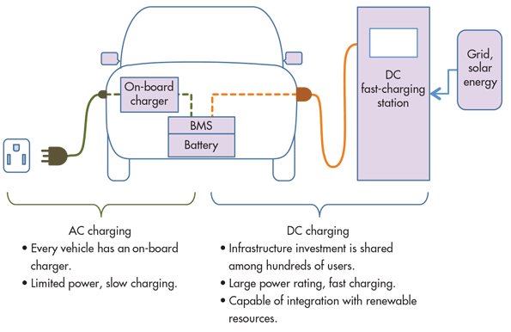
Charging EVs

Slide 11
Charging EVs
Another key point – the maximum charging rate also depends on the rating of the inverter in the EV (called ‘On-board charger’ in the diagram)
Taking the Hyundai Ioniq EV as an example, the rating of the on-board charger is 7.2 kW, so the maximum charging rate is 7.2 kW even if connected to a ‘Fast’ charger, giving a 5.5 hour charging time from 0 – 100%
However the Ioniq also has the capability for ‘Rapid’ 50 kW DC charging, giving a 0 – 80% charging time of just 40 minutes
Also note battery never normally at zero, so charging from 10% or 20% to 80% is more typical (slower charging rate above 80%)

Slide 12
Charging EVs
Charging at home: Dedicated charging point if possible – 75% of cost by Government - can be free with new car – typically 7kW rating
Can use domestic plug anywhere but 2.3 to 3 kW rating gives long charging times, not practical for newer EVs
Public charging points: network is rapidly expanding. Apps like Zap Map show you nearest / number of bays / how fast. Big range of points available ..
Fast charging (7 – 22 kW) - eg 7 kW at Hassocks station – 50% charge for most models in 3 – 4 hours
Rapid charging (43kW AC & 50 kW DC) – AC not so common, most are 50 kW DC – current EV models are compatible – typically 50% charge in about 30 minutes
Slow charging (3 kW) – mainly for overnight charging

Slide 13
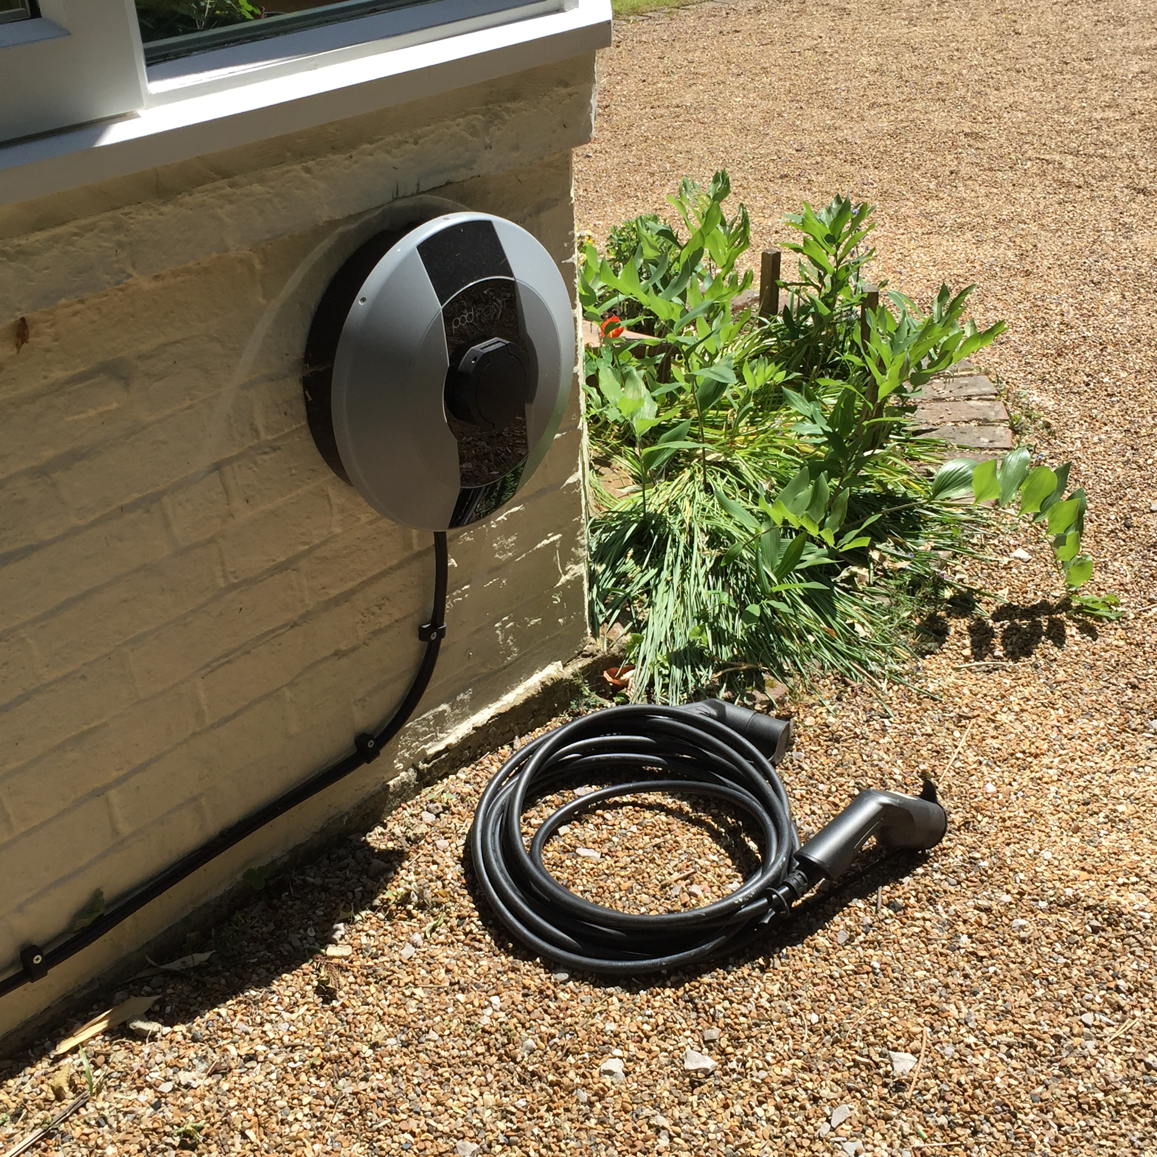
Charging EVs
Charging at home: In my case, Pod Point installed a 7kW rating charging point for £300 (incl VAT). Pod Point also received £400 grant - I had to complete an OLEV grant application form supplied by Pod Point
This is their ‘universal’ model – also available with captive cable 4.8m long (I needed longer cable – 10m cable expensive - £180!)

Slide 14
Zap Map page showing charging points in our area

Slide 15
Charging EVs
Two other details make EV charging complicated:
Connector types
Payment methods
Zap-map website has very helpful guides to explain
The ‘Type 2’ connector in now widely adopted for slow and fast charging.
Two types of DC rapid charge connectors, but cables are provided with multiple connectors
Payment methods also more complicated than ideal!
Smartphone app or
RFID card (radio frequency identification / contactless)
Pay-as-you-go or subscription options
Needs a bit of planning for new destinations
Easy once you get used to it!

Slide 16
Cost of Electric Cars
More expensive to buy, but lower prices expected as battery costs reduce, also …
Save on fuel, tax and servicing
Government grant to help with purchase – from March 2020 the scheme gives £3000 off new EV costing less that £50,000 (no grant now for PHEV)
Vehicle Excise Duty – rules getting complex, but most EVs will save at least £140 / year and more than £500 in first year (compared to many conventional models)
Fuel costs – can be as low as 3.5p to 4.5p per mile for EV compared to 13p to 17p+ for conventional petrol – for 8000 miles/yr savings of £700 to £1000+

Slide 17
Cost of Electric Cars (cont’d)
No Congestion Charge & tax advantages as company car
Energy providers such as Good Energy, OVO and Ecotricity have responded to the growing demand by launching electric vehicle tariffs
These offer special perks such as access to charging networks
Cost of charging is higher for commercial charging points – typically 30p/kWh (ie twice current domestic tariff). Competition likely to reduce this. Pubs (eg The Bull) often free to customers.
Another development is ‘Vehicle to grid’ technology, also referred to as 'V2G' which enables energy stored in electric vehicles to be fed back into the national electricity network (or 'grid') to help supply energy at times of peak demand. (The new Nissan Leaf offers this.)

Slide 18
Battery costs & guarantees
New Evs generally come with guarantee on battery performance
Eg Nissan Leaf – 5 year / 60,000 mile – protects against capacity loss of more that 25%
Renault originally preferred to lease the battery but dropped this in Nov 2019 (as second-hand values improved) – now 8 year / 100,000 mile battery warranty

Slide 19
How green are electric cars?
The big factors are:
How the electricity is generated
How vehicles and particularly batteries are manufactured and recycled
Many reports with varying data – battery manufacture is energy intensive
Decarbonisation of electricity generation is the key factor, along with lower energy use in manufacture
Recent reports agree that EVs give substantially lower lifetime greenhouse gas emissions compared to the average conventional vehicle
As electricity generation becomes less carbon intensive the benefits of EVs increase
In UK, based on 2019 carbon intensity, a Nissan Leaf is estimated to pay back manufacturing emissions in less than two years – with lifetime emissions one third of an average conventional car (12 years)

Slide 20
How green are electric cars? (cont’d)
Batteries: Mining and production of cobalt, lithium and other rare earth materials used in batteries are a major concern
Manufacturers are under huge pressure to improve the situation with much effort going into reducing both rare element use and battery costs
Manufacturers such as Tesla are putting huge investment into low cost / long life batteries designed to last for ‘a million miles of use’
Increasing use of renewable energy in battery manufacture will give significant environmental benefits

Slide 21
How green are electric cars? (cont’d)
Recycling of batteries is at an early stage but is also receiving much attention
Manufacturers already pledge to recycle or reuse battery packs
Used vehicle batteries are increasingly being used for static grid-support batteries
The greater numbers in future will drive up recycling efficiencies and reduce impact on the environment
Note that the status quo has many of the same problems

Slide 22
How about the future?
Key Japanese manufacturers believe future cars will use hydrogen fuel cells
Honda and Toyota think the technology’s superior energy density will triumph over batteries … but no sign of this yet
The Toyota Mirai has been on sale since 2015 and gets brilliant reviews. It has a range of about 300 miles but few filling stations currently. Price is very high - £61,500
Honda also has a fuel cell model on sale – the Honda Clarity

Slide 23
How about the future?
Ultimately it seems the predictions being made by Tony Seba (American author, speaker and entrepreneur) are persuasive
His ‘Future of Transportation’ presentation is impressive (on You Tube)
He sees a tipping point coming soon where reducing EV costs, wide acceptance of self-driving vehicles, along with low renewable energy costs (particularly solar PV)
Resulting in dramatic changes within 10 years – EVs become dominant and car ownership becomes much less common
Instead most cars owned and operated by large fleet organisations

Slide 24
More information …
Although not fully up to date, the guide to electric cars produced by Steyning 10:10 Climate Action Group is still very informative - available to download from their website ...
www.1010steyning.org/electric-cars/
Next Green Car website – guide to low emission cars - www.nextgreencar.com/
Zap Map – charging points, charging speeds and connectors, vehicle guides - www.zap-map.com/
Which? magazine www.which.co.uk (search ‘electric cars’)
Tony Seba ‘Future of Transportation’ - www.youtube.com/watch?v=y916mxoio0E

Slide 25
More information …
OVO website is informative, including details of their ‘smart chargers’ and Vehicle to Grid technology - www.ovoenergy.com/electric-cars/vehicle-to-grid-charger
Ecotricity also provide useful information including details of their extensive charging network and EV tariff - www.ecotricity.co.uk/for-the-road
Pod Point (EV charging) – www.pod-point.com
BP Chargemaster (EV charging) - www.bpchargemaster.com

Slide 26
EV owners tell all …
Dinah (& Guy) Pryor – Hyundai Ioniq
Philip Eckstein – BMW i3
Ian Chishom - Renault Zoe (second-hand)
John Willis – Kia Niro Plug-in Hybrid

Slide 27
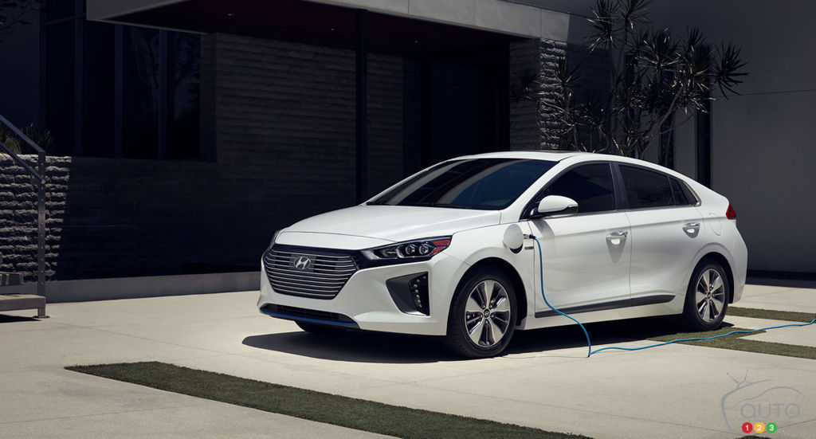
EV owners tell all …
Dinah (& Guy) Pryor – Hyundai Ioniq

Slide 28
EV owners tell all …
Philip Eckstein – BMW i3

Slide 29
EV owners tell all …
Ian Chishom - Renault Zoe (second-hand)

Slide 30
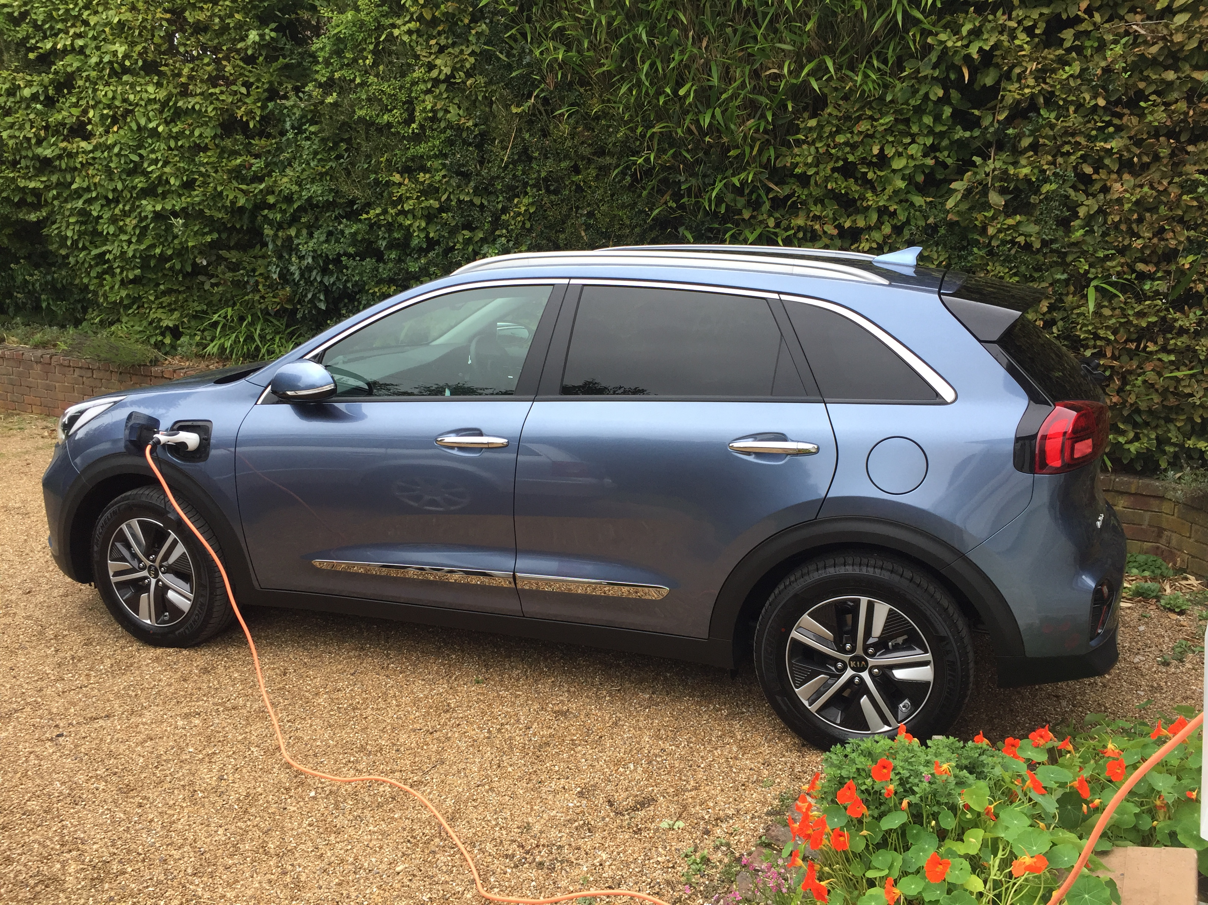
EV owners tell all …
John Willis – Kia Niro Plug-in Hybrid

Slide 31
Any questions?

